Slide 1

Real-World E-Commerce Web Application
A functional system for product browsing, cart, checkout, and admin order management, implementing real business rules and handling edge cases for scalability and maintainability.
Key Outcomes
Implements real business rules (stock control, order lifecycle).
Handles edge cases, not naive CRUD behaviour.
Designed for scalability and maintainability.
Examples
Stock deducts only when order is confirmed.
Cancelled order restores inventory automatically.

Slide 2

Problem Statement: Gaps in Student E-Commerce Projects
Generic & UI-Focused
Missing Core Logic
Current student projects often lack real-world logic, focusing only on UI.
Absence of inventory consistency and robust order workflows.
Real-World Gaps
No stock re-validation during checkout or proper rollback handling.
For example, duplicate orders on refresh due to missing idempotency, or cart quantities exceeding available stock.

Slide 3
Proposed Solution: Rule-Driven E-Commerce System
01
02
03
Product Listing
Validated Cart
Structured Checkout
With effective filters and availability indicators.
Session-persisted items with quantity validation.
Smooth flow with address and delivery logic.
04
05
Order Lifecycle
Admin Dashboard
Inventory synchronization and status transitions (e.g., Pending → Confirmed).
Controls system state and provides stock change logs for traceability.

Slide 4

Market Relevance & Project Scope
Relevance in Real Applications
Project Scope
Single-vendor functional commerce platform.
Small businesses transitioning to online stores.
Focus on correctness and workflows, not payments.
Use-cases like college merchandise, bakeries, or rentals.
Need for lightweight yet reliable systems.
Examples include local bakery inventory caps per day or a merch store with variant-based stock management.

Slide 5

System Features: User Side
1
2
3
Product Listing
Smart Cart
Secure Checkout
Displays products with clear availability indicators.
Includes quantity validation and dynamic total recalculations.
Incorporates address and delivery logic, blocking insufficient stock.
If stock reduces during checkout, the user is warned, and the order is stopped. Price updates trigger cart recalculation.

Slide 6


System Features: Admin Dashboard
Product Management
Order Status Updates
Inventory Tracking
Manage products, variants, and stock levels.
View and update order statuses, reflecting instantly for users.
Track inventory changes and ensure stock restoration on cancellation.
For example, when an admin marks an order as "Packed," the user sees an immediate status update, and restock events are logged.

Slide 7

Architecture & Technologies Used
Architecture
Tech Stack (Example)
Client → API Layer → Database.
Frontend: React / Next.js
Stateless backend with robust validation.
Backend: Node.js + Express
Database: PostgreSQL / SQLite
Auth: JWT
Styling: Tailwind
Order APIs enforce lifecycle rules, and the cart is stored server-side for reliability.

Slide 8
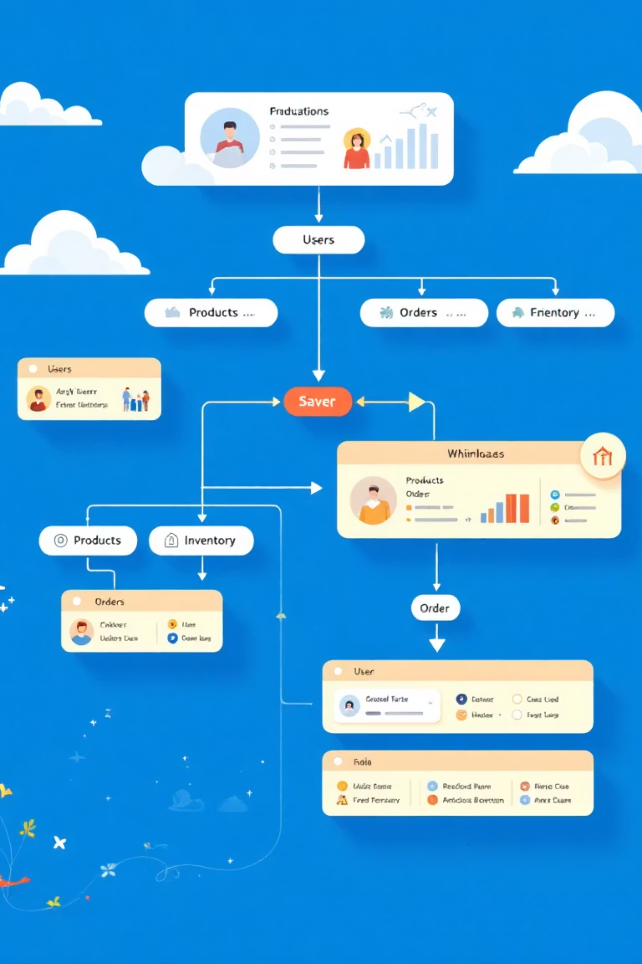
Database Design
Core Tables
Users, products, product_variants, cart_items, orders, order_items, inventory_logs.
Design Principles
Avoid duplicated state and preserve historical pricing snapshots.
Order_items store the price at purchase time, and inventory_logs track every add/remove event for full traceability.

Slide 9



Edge Cases & Validation Handling
Critical Scenarios
Duplicate order prevention, stock re-validation during checkout, quantity and input validation.
Reliability Focus
Meaningful error responses and consistent state transitions.
Payment retries create new transactions, not duplicates, and negative or zero quantities are always rejected.

Slide 10

Conclusion & Future Enhancements
Current Achievements
Future Enhancements
Real-world logic beyond basic CRUD operations.
Online payments integration for seamless transactions.
Inventory-aware checkout system for accuracy.
Analytics dashboard for data-driven decisions.
Admin-controlled operational workflow for efficiency.
Multi-vendor marketplace support for expansion.
Potential additions include a coupon/discount engine and delivery partner integration.

